Slide 1
Fable Farm
Edison Yang
Kevin Monahan
Jacob Weaver
Cary McLaughlin

Slide 2
Idea Phase
Merchandising Site for MN Loons
Inventory Management and Marketing Site for Farmers Market
Fable Farm

Slide 3
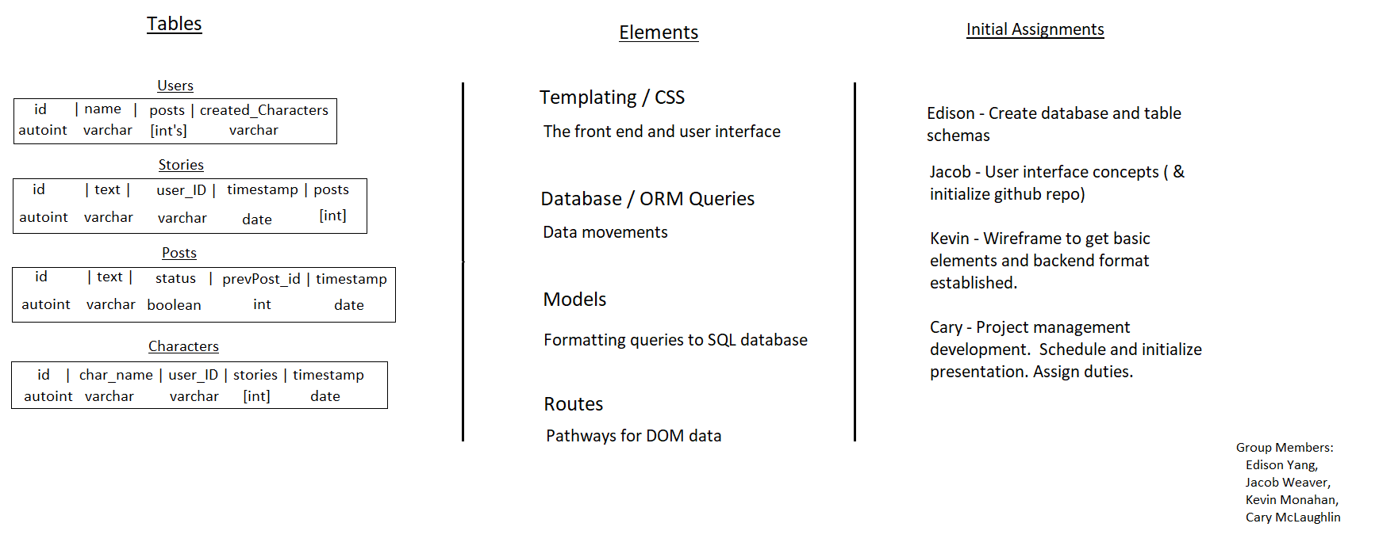
Fable Farm Initial Planning

